Slide 1
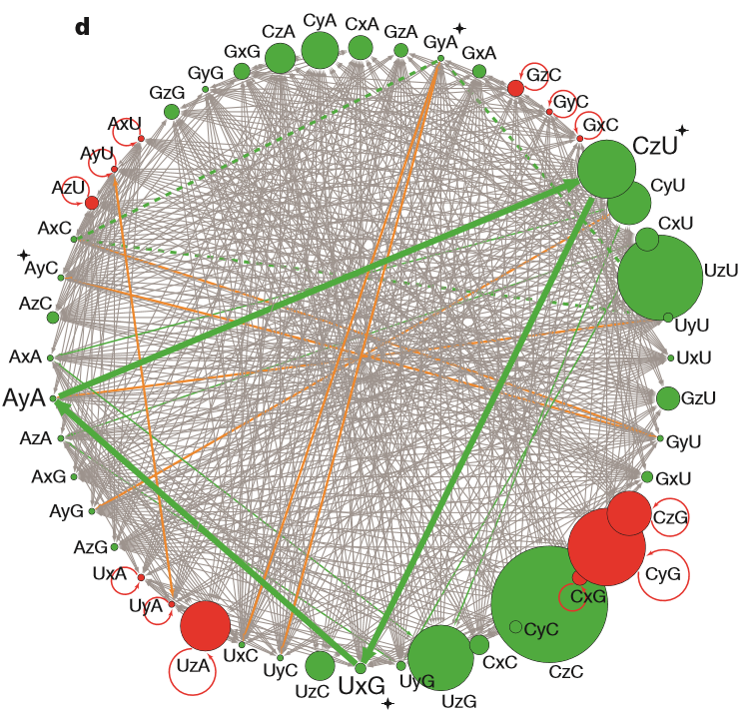
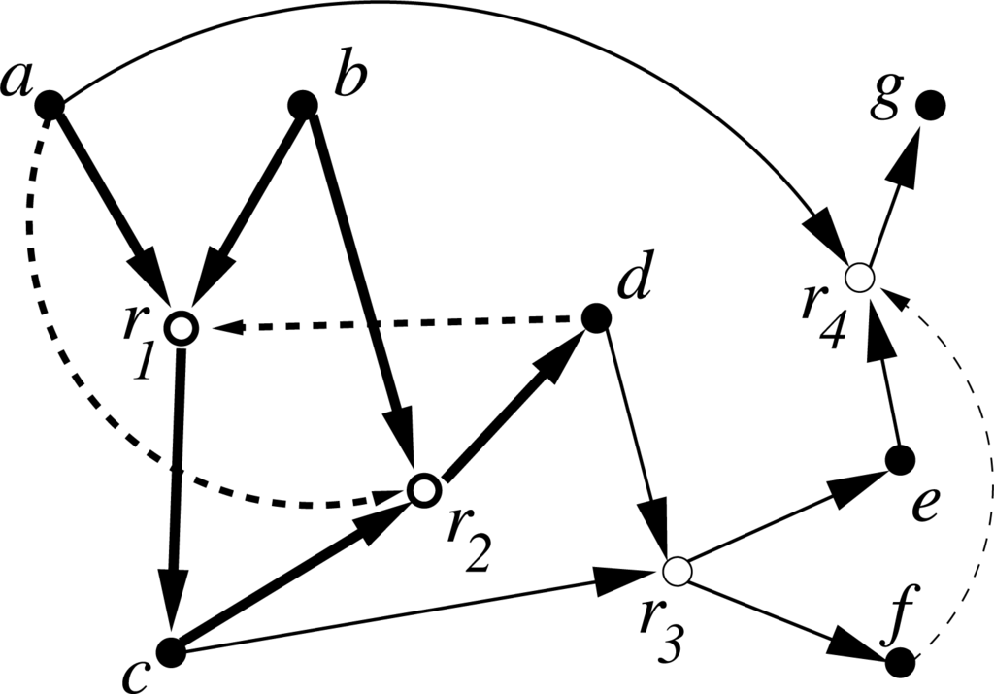
Cooperative RNA Networks
Cole Mathis
SESE598 Spring16

Slide 2
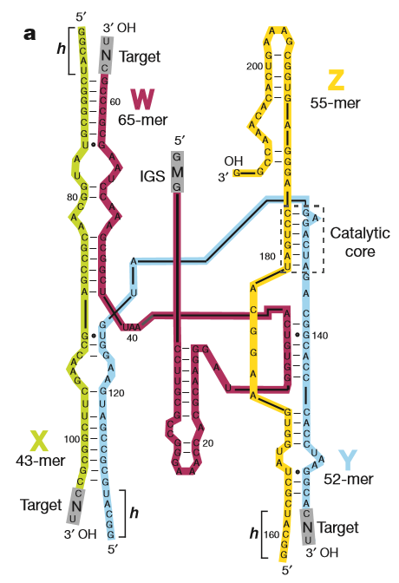
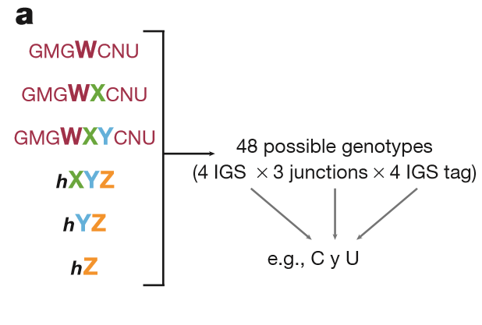
The Azoarcus ribozyme system

Slide 3
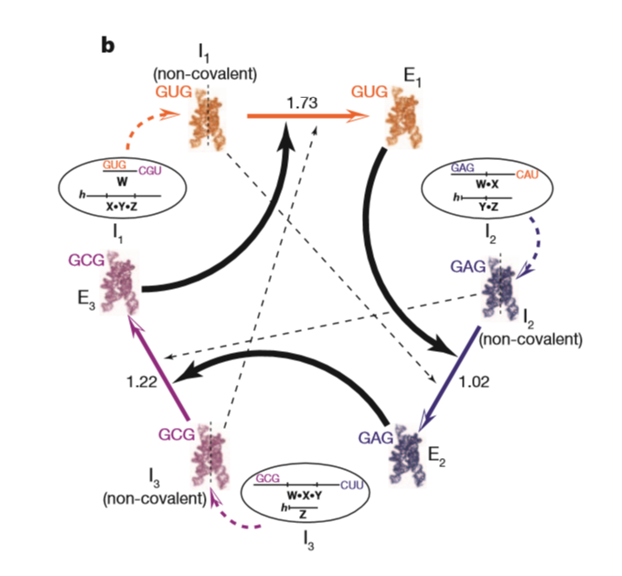
Cooperative RNA Networks

Slide 4
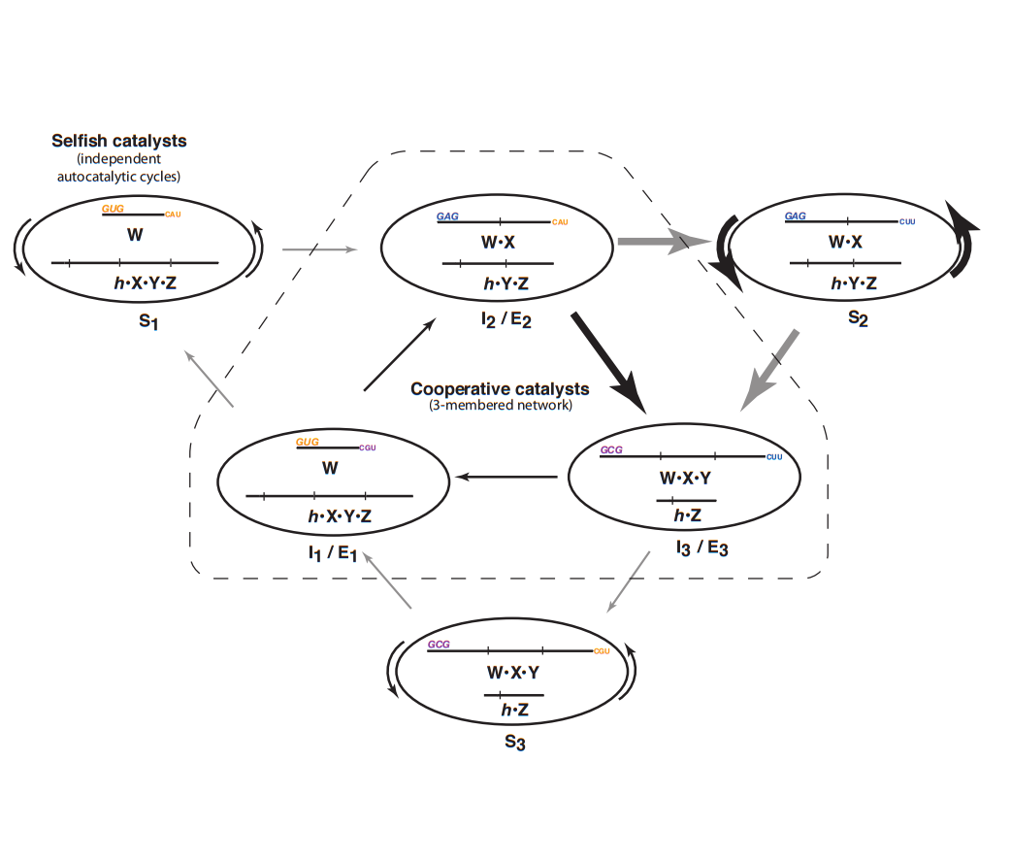
Cooperative RNA Networks

Slide 5
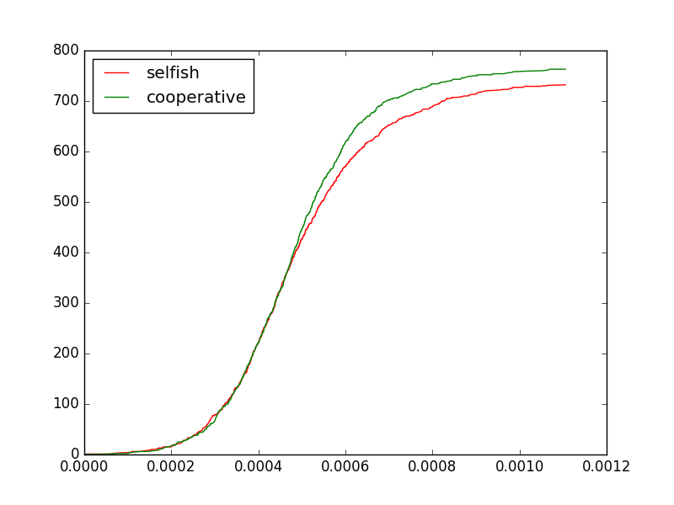
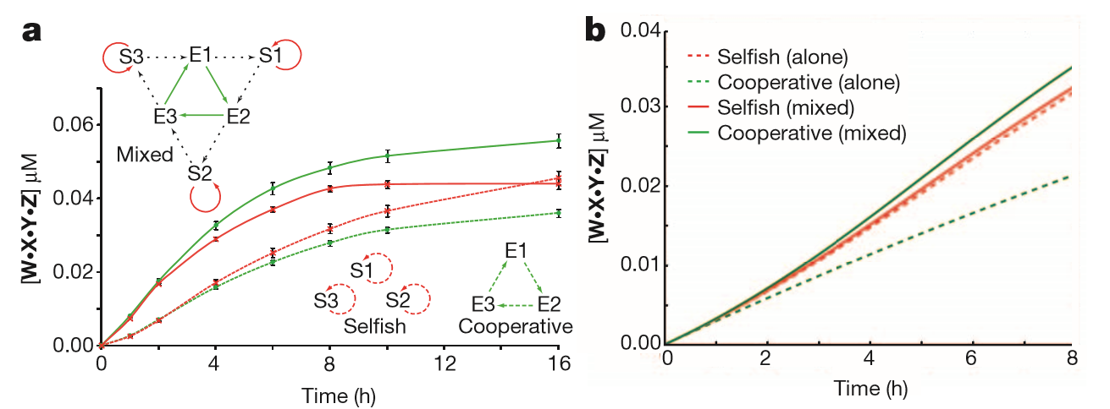
Cooperative RNA Growth Rates

Slide 6
Coarse Grain!

Slide 7
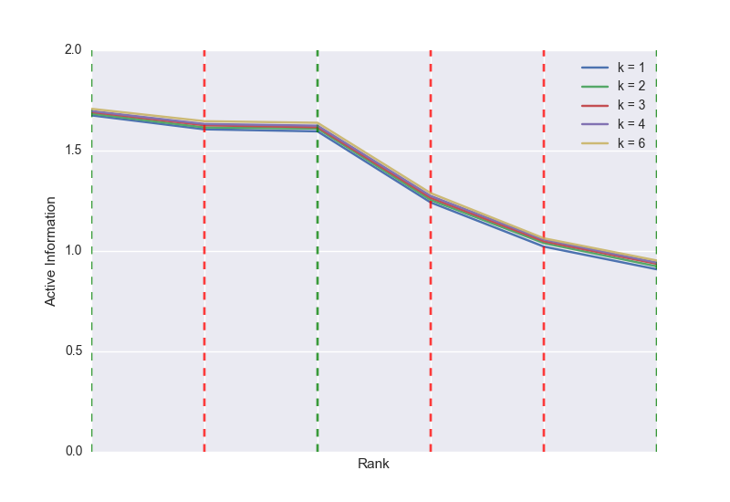
Active Information Scaling

Slide 8
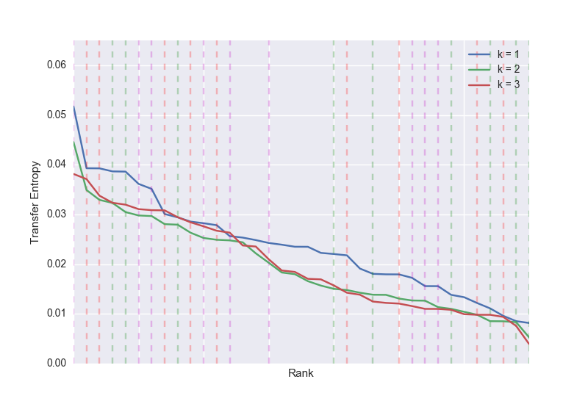
Transfer Entropy Scaling

Slide 9
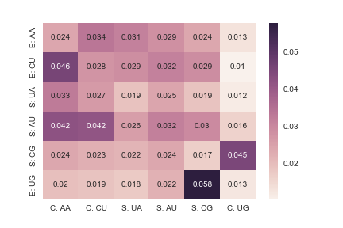
Transfer Entropy Details

Slide 10
